Slide 1



Oren Eini
We!
ayende@ayende.com
http://www.ayende.com/Blog/

Slide 2
Who am I?
Oren Eini (a.k.a: Ayende Rahien)
Blogger (http://www.ayende.com/Blog/)
Author of Rhino Mocks
Senior Developer at We! Consulting Group

Slide 3
Interaction tests
No state to test?
  ExecuteCommand
  SendSms
Complex collaborations
  Get user from repository, if has phone, send sms, otherwise, log error and send email.

Slide 4
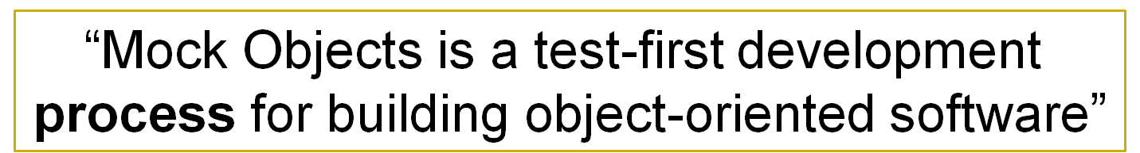
Mocks, Stubs and Fakes, Oh My!
Objects do not work in isolation
  But we want to test them that way
Mocking dependencies allows to test in isolation.
Definitions:
  Fake – working implementation, but not a useful one (a DAL that uses a dataset rather than a database).
  Stub – empty implementation, may optionally record the calls made to it.
  Mock – pre-programmed for a certain scenario, verify that the scenario was executed properly.

Slide 5
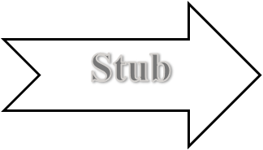
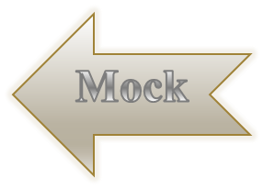
Test that an SMS was sent
State base testing
Assert.IsTrue(
webService.SentSMS);
Interaction base testing
Expect.Call(
webService.SendSMS(“1234”,”hi”));
Notes:
Test interactions between objects
Test the state of an object

Slide 6
Interaction Based Testing
Advantages:
Disadvantages:
Helps test in isolation
Handles complex scenarios better
Encourage best practices
More complex
Require a different mode of thinking
Need to understand what is being tested – not always as clear

Slide 7
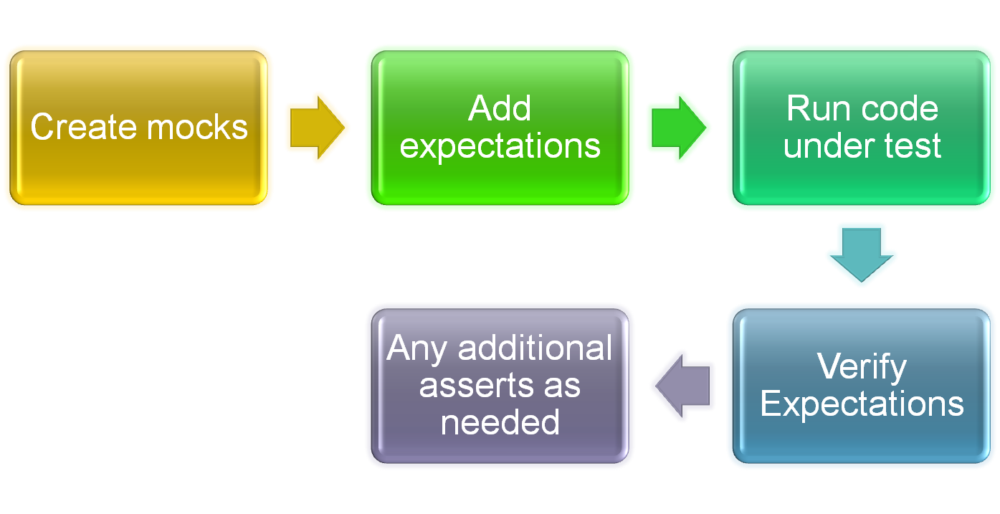
Structure of interaction based test

Slide 8
Rhino Mocks
Version 3.1
Open Source
Strongly typed mocks
Explicit Record & Replay model
Plays well with refactoring tools and the compiler
Flexible
Open (both OSS and to change)

Slide 9
Expectations vs. Setup
Two different ideas
Expectations – what I am testing
Setup – mock object that is used instead of real implementation.

Slide 10
Sample Test
[Test] public void WillSendGreeting() {
MockRepository mockRepository = new MockRepository();
//Record mode
ISmsSender sender =
mockRepository.CreateMock<ISmsSender>();
//Create expectation
sender.SendSms("EveryoneInThisTalk",
"Welcome to DevTeach!");
//Move to replay mode
mockRepository.ReplayAll();
//Actual code under test
SayWelcome(sender);
//Verify expectations has been met
mockRepository.VerifyAll();
}

Slide 11
Enough with talk, let see some code
Scenario:
I need to send an SMS as a result of an action.
The SMS Service cost $$ per message, can’t test against real implementation.
The service is not reliable.

Slide 12

Special Edition: Legacy Tests
Partial Mocks
Enabling Extract & Override

Slide 13
What goes with mocking?
Dependency Injection
Inversion of Control
Program to Interfaces
Separation of Concerns

Slide 14
Words of caution
Test Paralysis:
  Leave room for change
  Do not specify too much (locked by the tests)
Make sure that the test are explicit in what they test:
  Use Message(“documentation”)
  Assert if needed

Slide 15
What not to mock?
Code that you don’t own
Small granularity code
  System.Data
  Fluent interfaces

Slide 16


